Slide 1
Final project: CI/CD pipeline Spring Petclinic
Valery Yurchenko,
EPAM DevOps external course

Slide 2
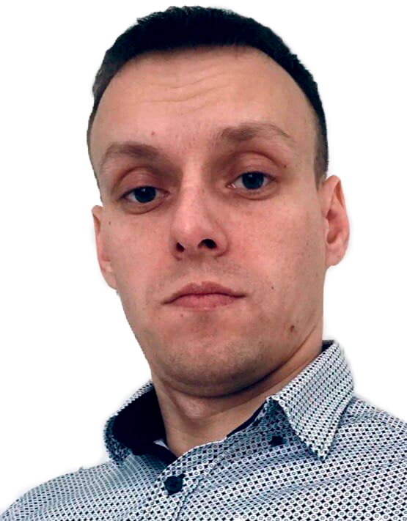
Let me to tell some facts about myself:
I am 36
I am from Ops: System Administrator / Support Engineer (Windows, GNU/Linux) 15+ years / Head of IT Department at Matrapac Ukraine.
My goal is to upgrade my skills and start to work as System Engineer with EPAM.
I like System Engineering and System thinking and believe that system practices make our world better place.

Slide 3
What is my motivation?
This is my first CI/CD project, who teaches me, how it works.
In process of creating of this project I get many knowledge (subjectively) in tools, what I used.
Relevance:
My method is relevant, because it allows in a short time and with the least effort on the part of a software developer to organize the assembly of the artifact from the source code and the delivery of the artifact to the testing and staging environment.
Goals:
Automation
Reducing the entry threshold
Savings
Security

Slide 4
Selected technology stack:
GNU/Linux
GitHub
Jenkins
Ansible
Docker
Terraform
AWS
Telegram

Slide 5












Scheme of my project:
Send JAVA
Artifact to Docker Image
Source
Code
Test
Code
Build
artifact
Push
Image to
DockerHub
Build
Image
GitHub
WebHook/Poll SCM
Docker
pull
Getting
image
Build EC2 instances
Git push
from coder
Get info for Terraform Outputs
and write to variables
Configure instances and
starting docker container
Send message to team
with addresses of servers
message
Developer
message
DevOps engineer

Slide 6
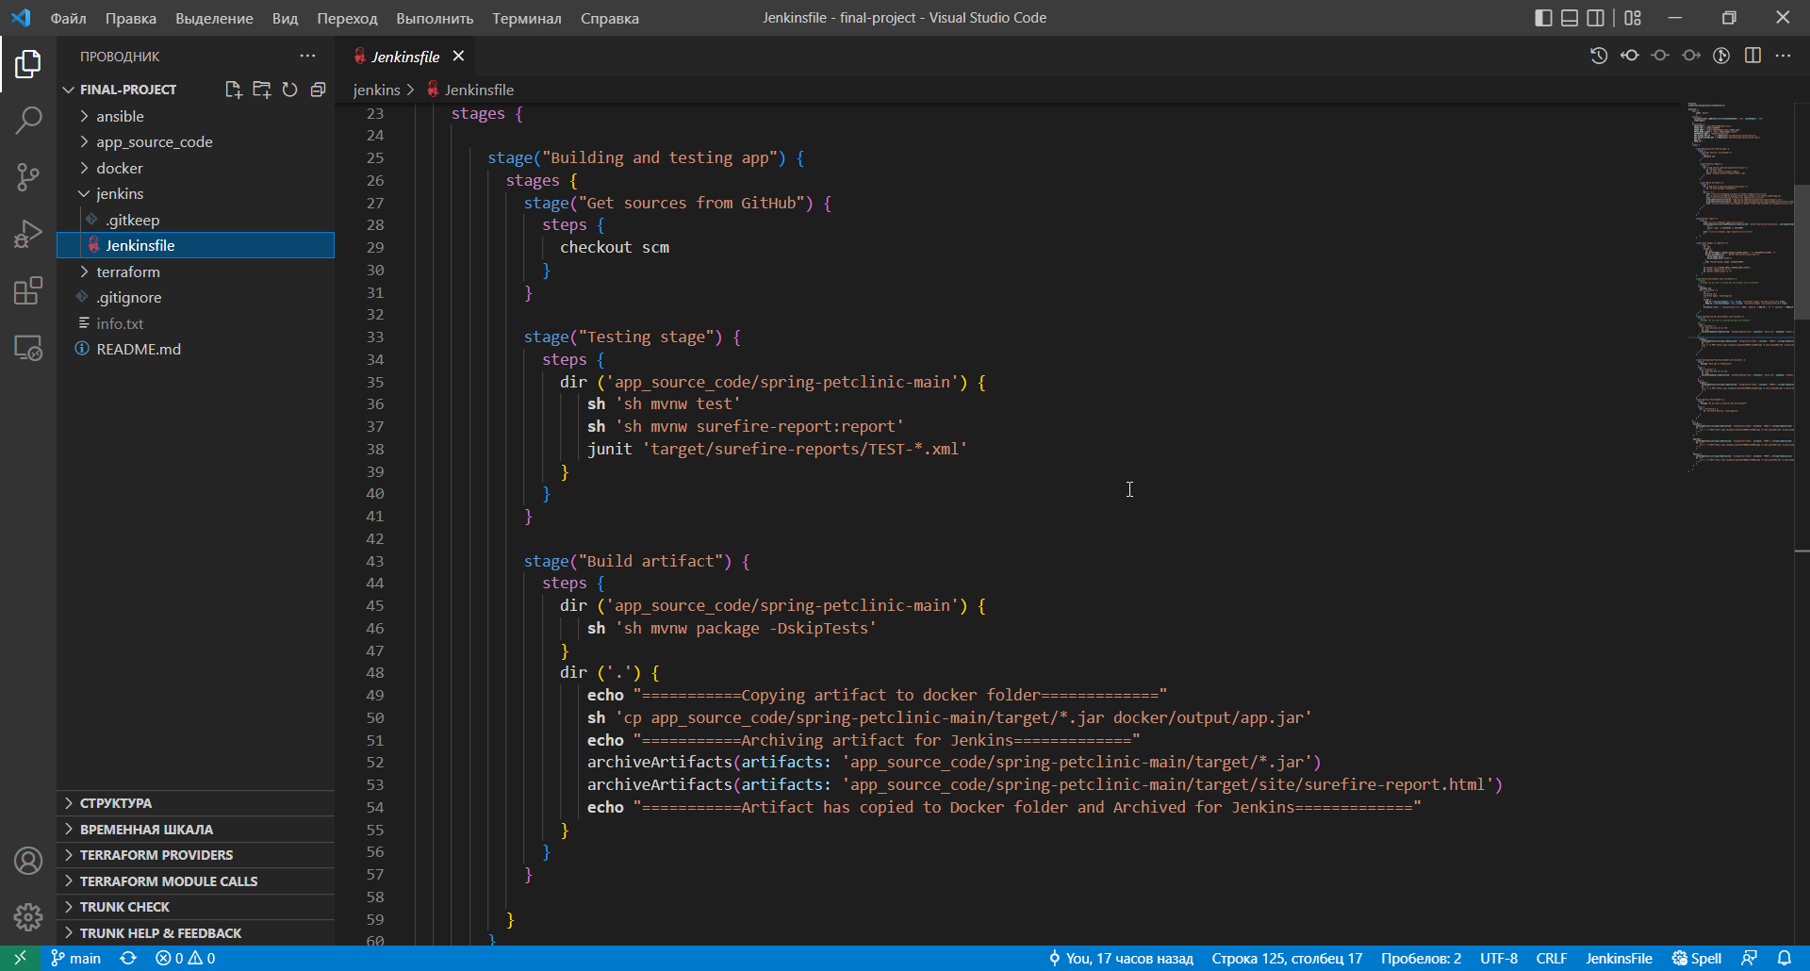
Realization:
Testing and Building:

Slide 7
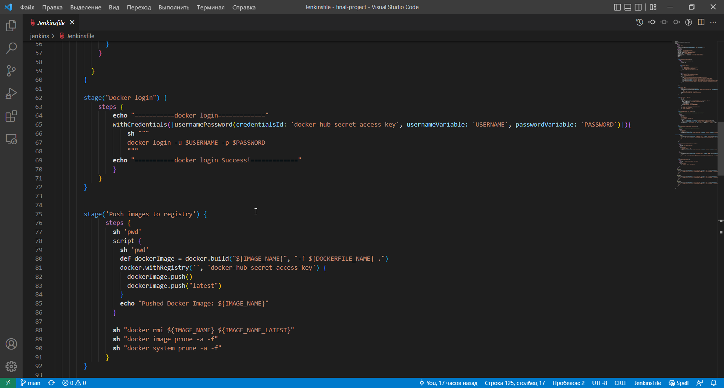
Creating of the Docker Image and pushing to DockerHub:

Slide 8
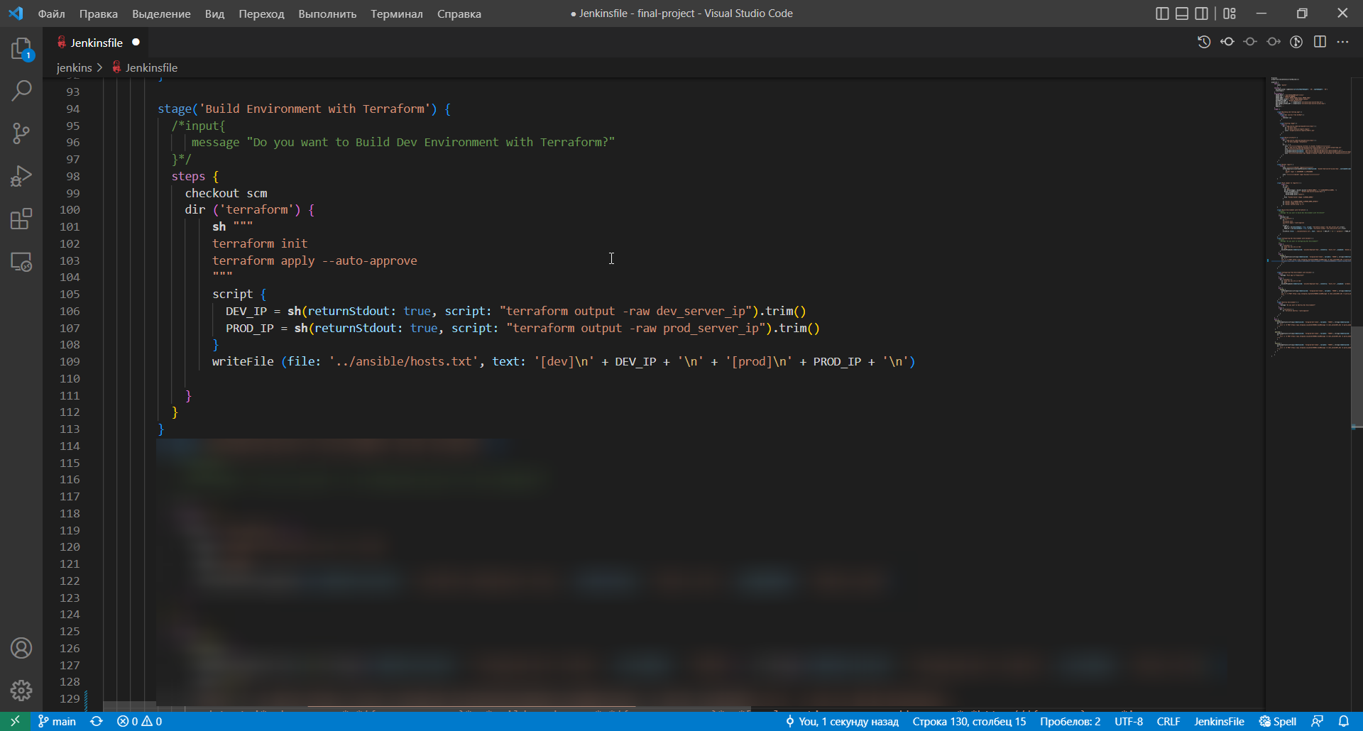
Building instances with Terraform:

Slide 9
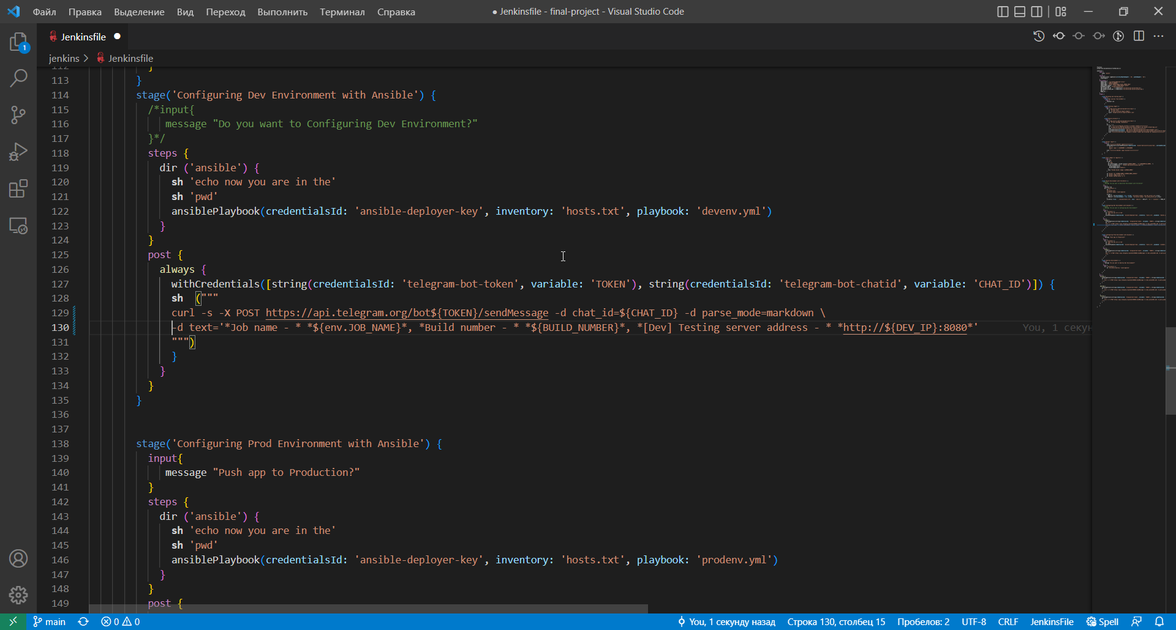
Configuring instances with Ansible:

Slide 10
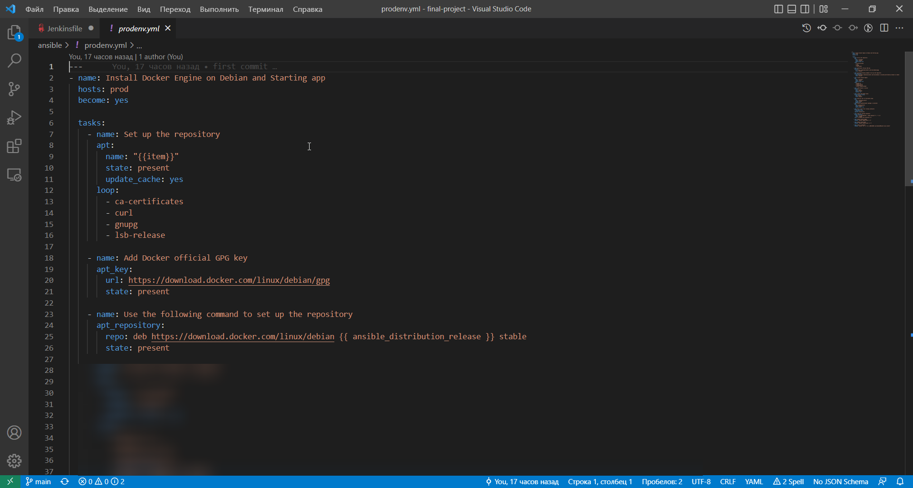
Ansible Playbook.yml:

Slide 11
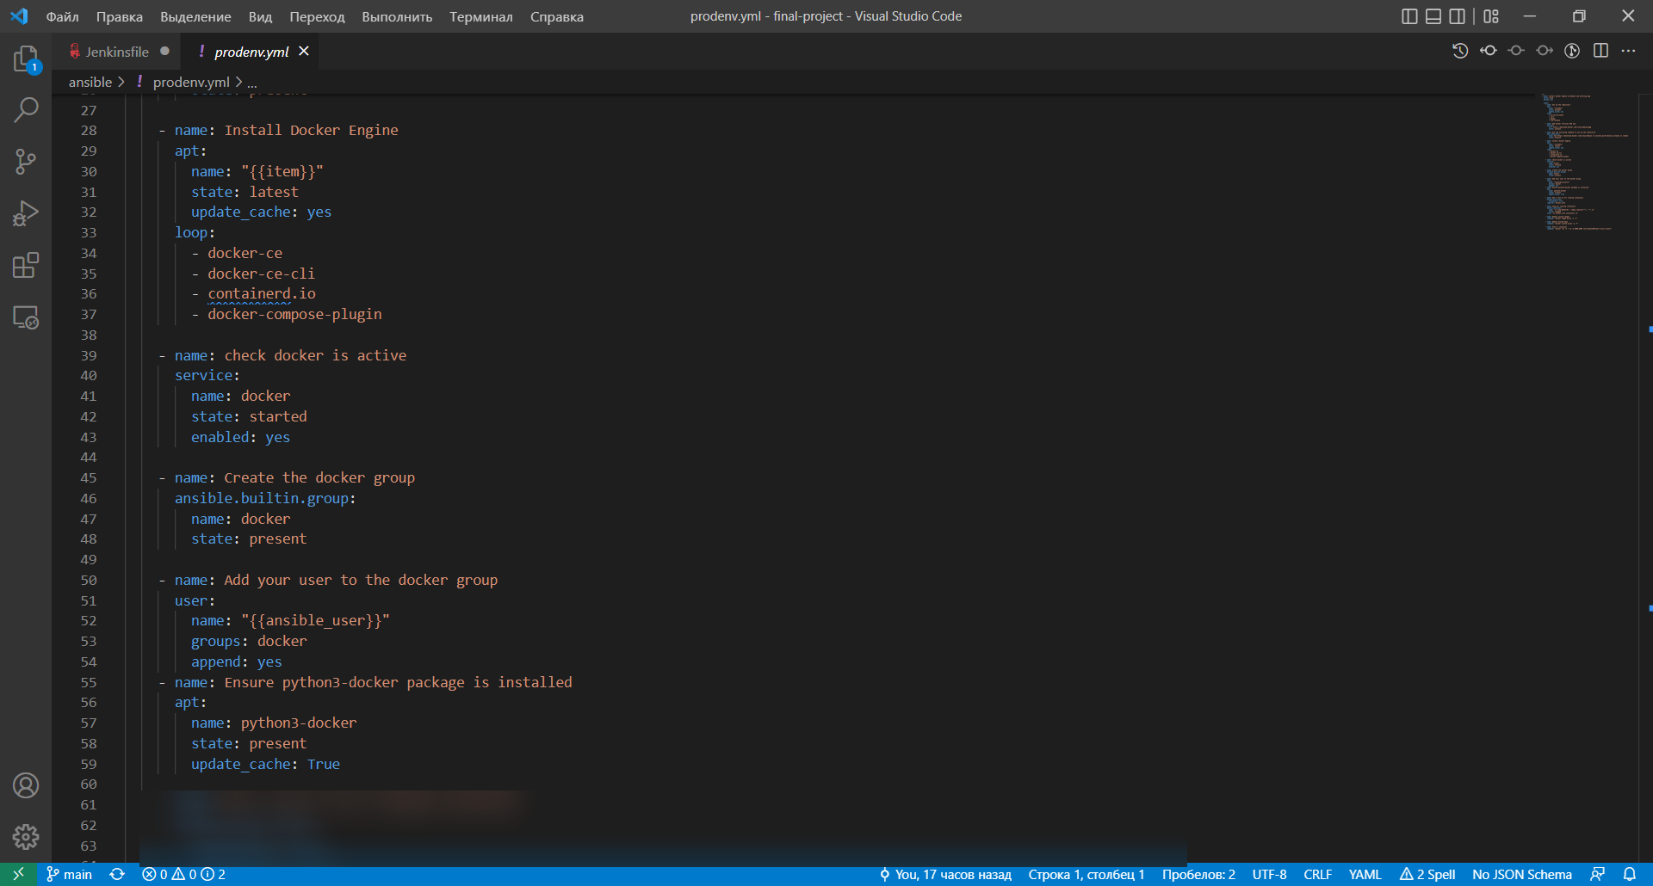
Ansible Playbook.yml:

Slide 12
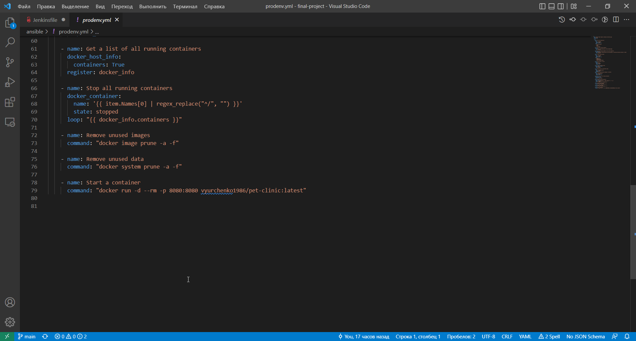
Ansible Playbook.yml:

Slide 13
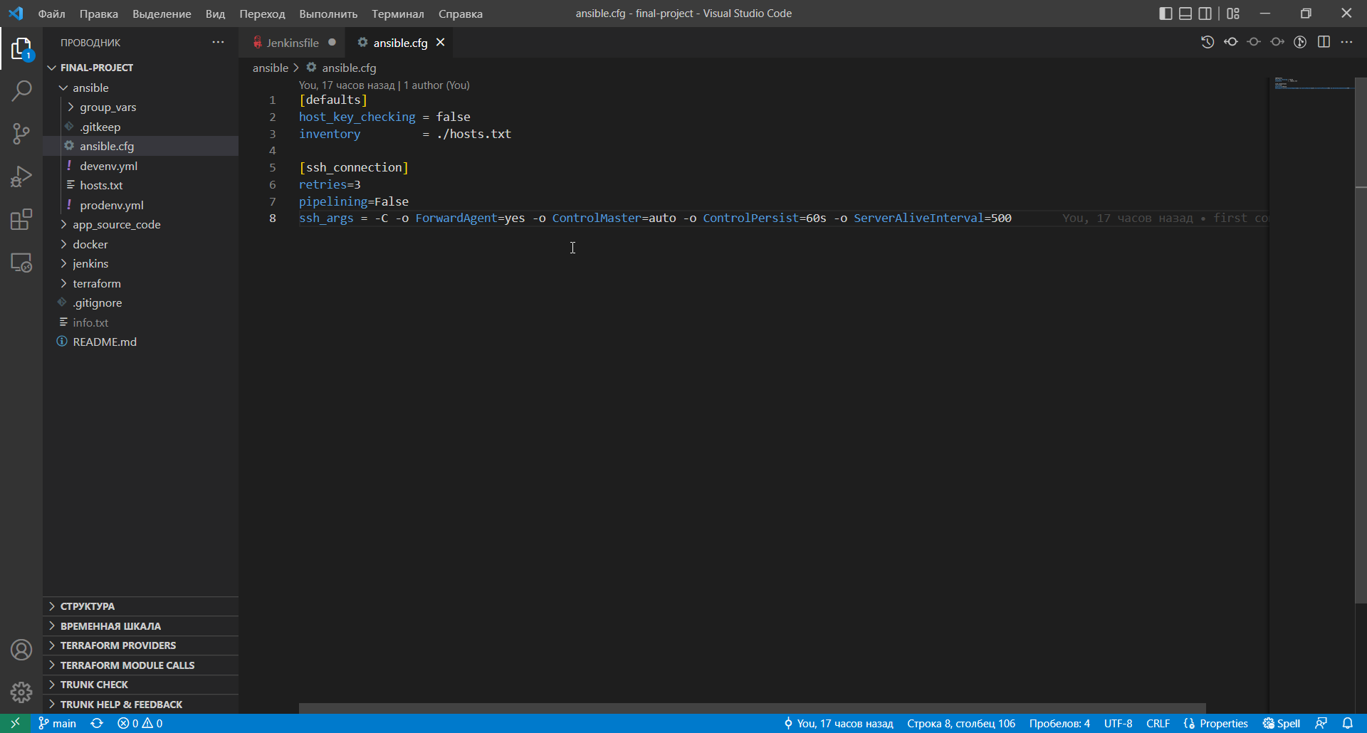
Ansible Ansible.cfg:

Slide 14
Live demonstration

Slide 15
Thank you for your attention!

